Slide 1
Drug repositioning web application using compound API
By Sarawoot somin

Slide 2
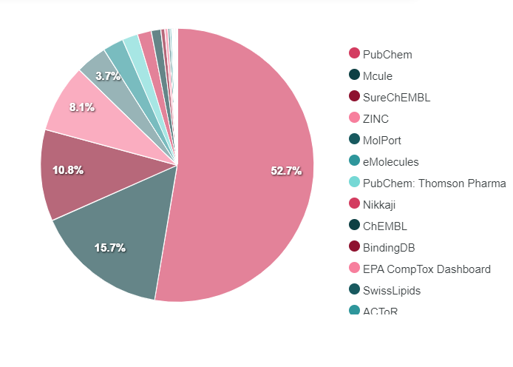
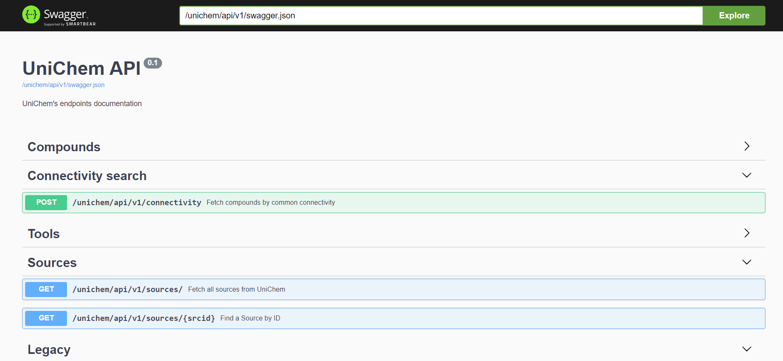
Compound API online
https://www.ebi.ac.uk/unichem/api/docs#/
This is non-redundant database of pointers between chemical structures and EMBL-EBI chemistry resources. Its purpose is to optimise the efficiency with which structure-based hyperlinks may be built and maintained between chemistry-based resources, and is particularly suitable for creating such links 'on the fly' (by use of REST web services).

Slide 3
The web application
There are three tabs, including “Search”, “Source” and “About”
- “Search” tab is to fetch multiple source data sets for a given compound with common connectivity to a given id (UCI) on the database source.
- “Source” tab is to show all source of the compounds.
- “About” tab is to show the author information and the overview of the proposal.

Slide 4
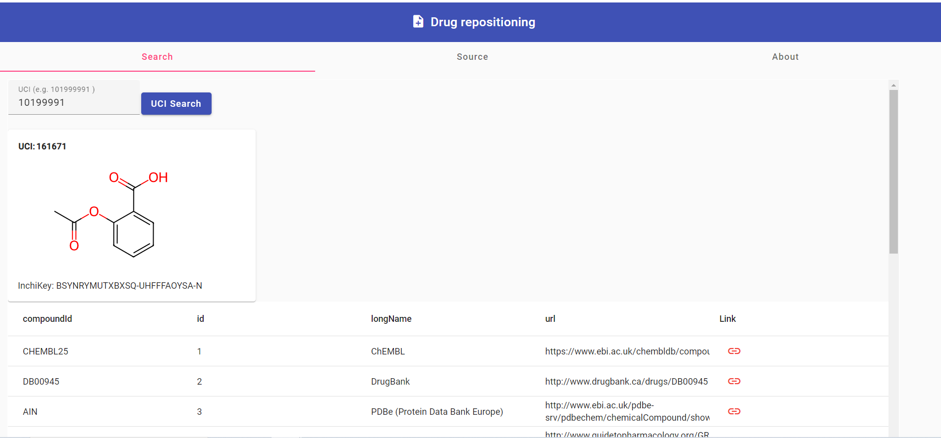
Search feature
- The web application recommend retrieves the compounds from different sources by UCI search.
- The system also display the chemical structure following the UCI search.

Slide 5
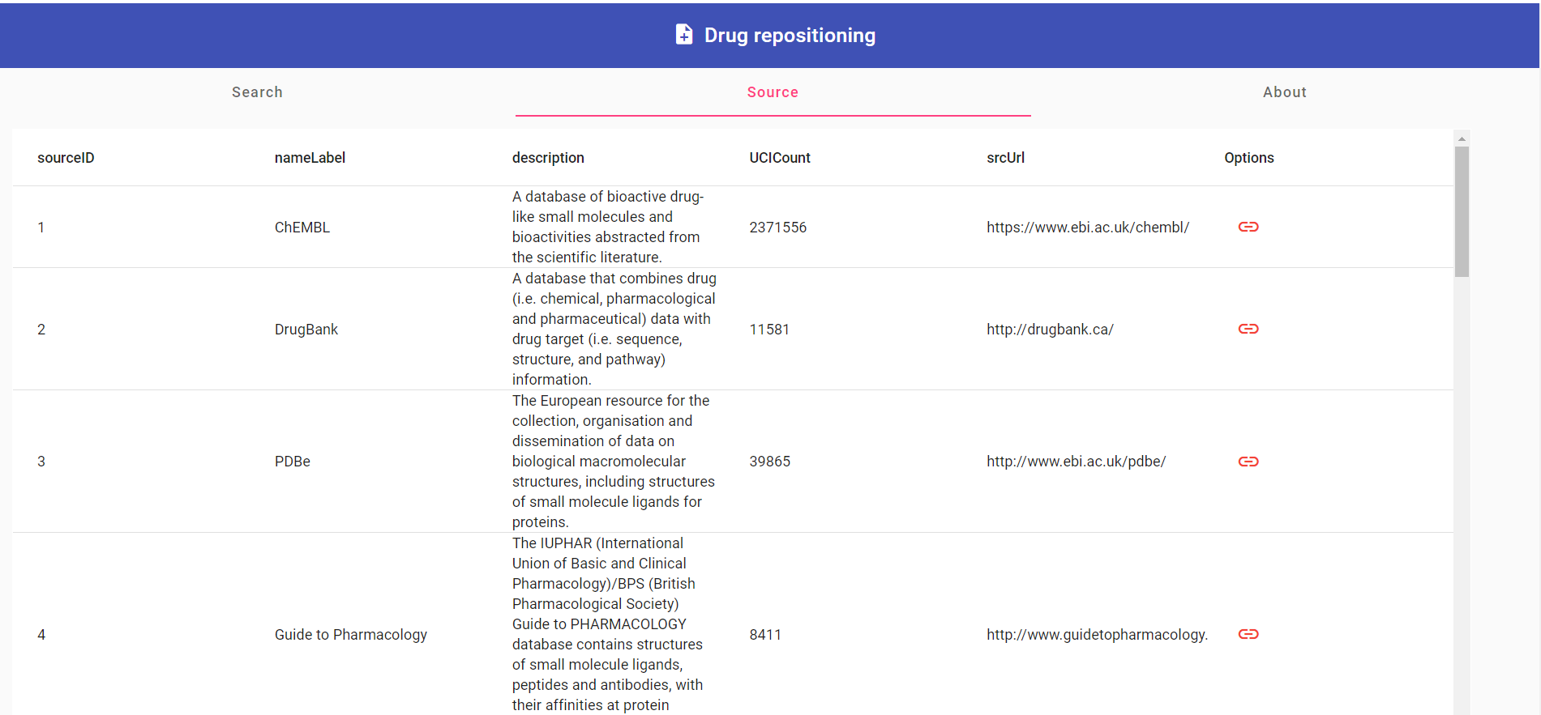
Source feature
The web application shows all sources of the compounds.

Slide 6
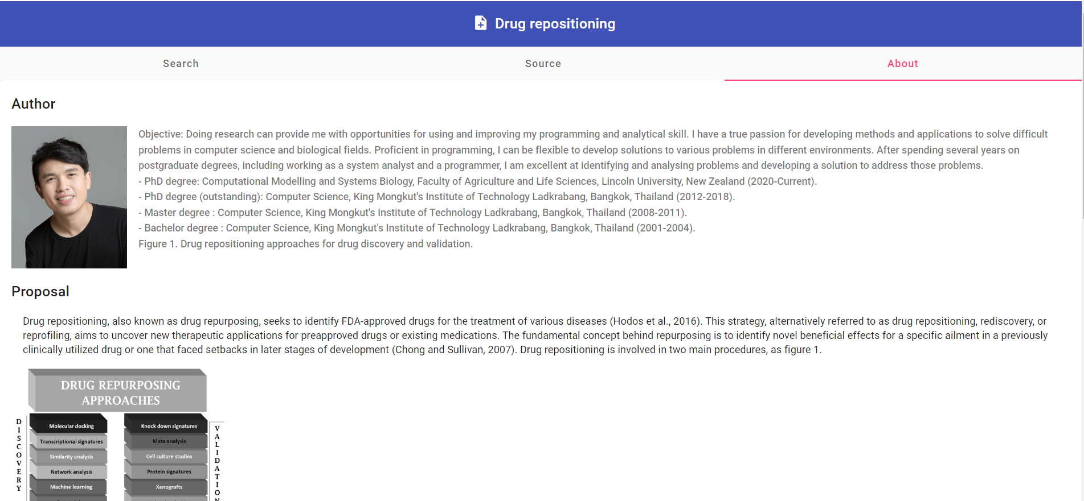
About feature
Author information, and the research of interest

